Slide 1


Data Warehouse Operational Data Store (ODS)
Michael Pomatto
Data 742 10/1/2019

Slide 2
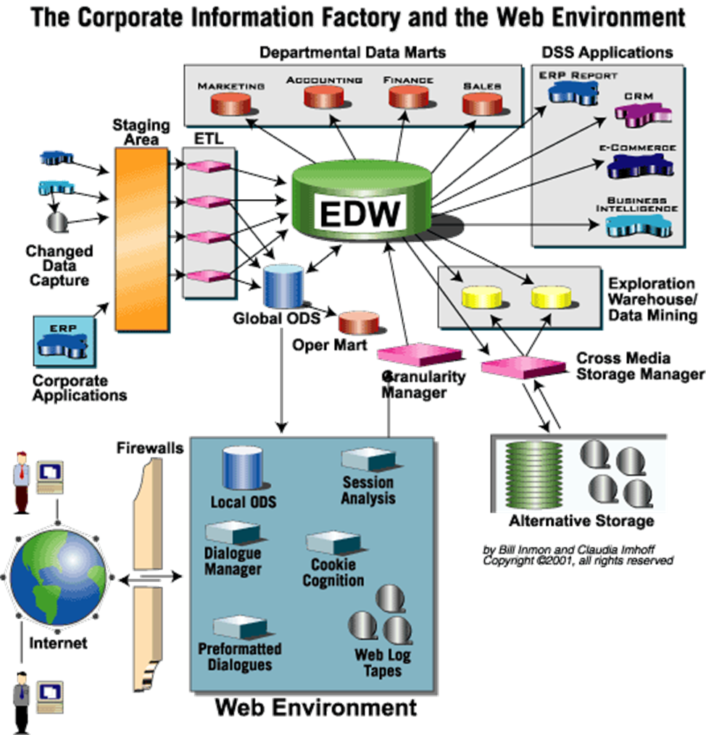
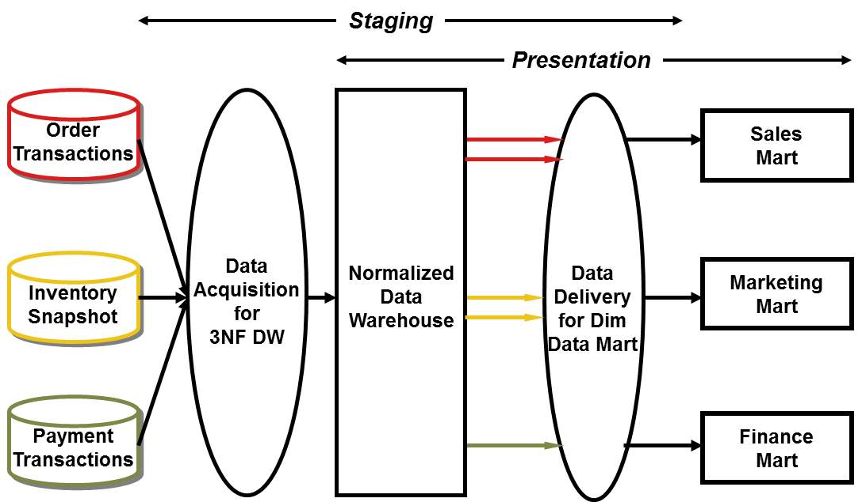
Inmon’s CIF
Subject-oriented
Integrated
Current
Volatile
Operational functions.
Optional
Never resides in EDW
Organizations may have multiple ODS in place
1.
2.

Slide 3
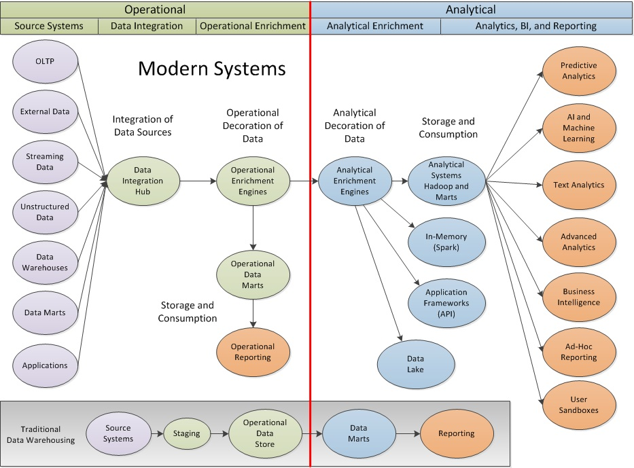
Modern
Hybrids

Slide 4
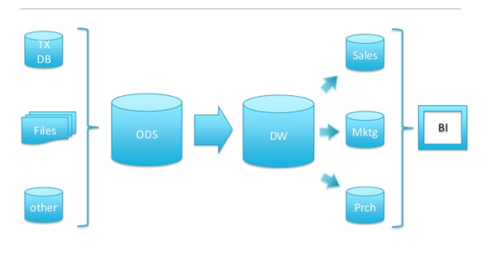
Hadoop and EDW (Cloudera) – No Hadoop
Slide 24 https://www.slideshare.net/Hadoop_Summit/hadoop-and-enterprise-data-warehouse

Slide 5
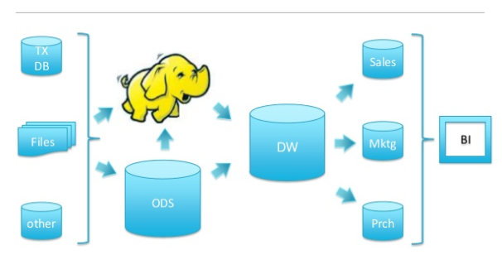
Hadoop and EDW (Cloudera) – Adjacent System
Slide 25 https://www.slideshare.net/Hadoop_Summit/hadoop-and-enterprise-data-warehouse

Slide 6
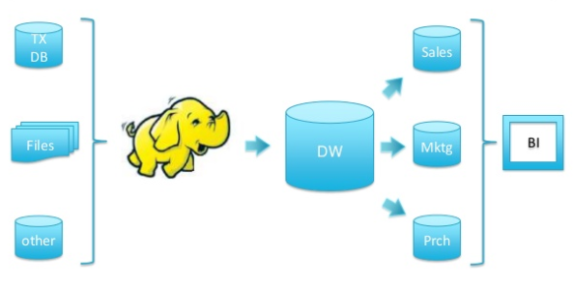
Hadoop and EDW (Cloudera) – ETL Engine
Slide 26 https://www.slideshare.net/Hadoop_Summit/hadoop-and-enterprise-data-warehouse

Slide 7
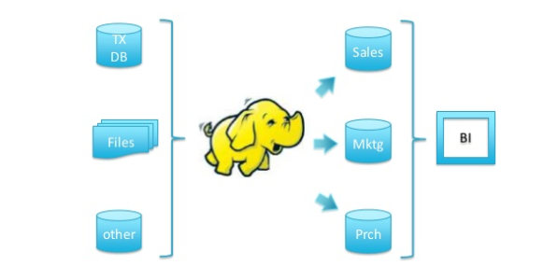
Hadoop and EDW (Cloudera) – Tiered Data Warehouse
Slide 27 https://www.slideshare.net/Hadoop_Summit/hadoop-and-enterprise-data-warehouse

Slide 8
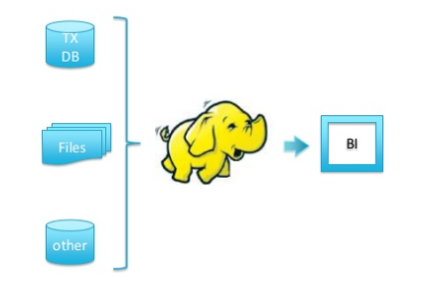
Hadoop and EDW (Cloudera) – Analytical Query Engine
Slide 28 https://www.slideshare.net/Hadoop_Summit/hadoop-and-enterprise-data-warehouse

Slide 9
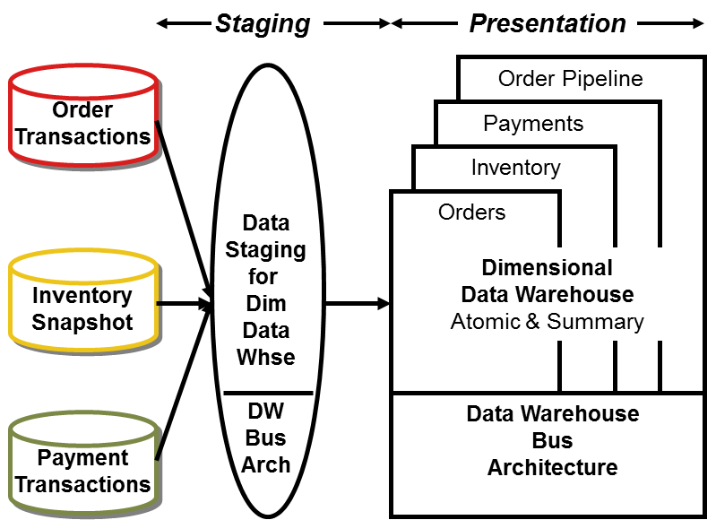
Inmon / Kimball Comparison
https://www.kimballgroup.com/2004/03/differences-of-opinion/
Kimball Bus Architecture
Inmon Corporate Information Factory

